Slide 1



ICTC Training program

Slide 2
Versioning
Version | Date de version | Auteur / Contributeurs | Nature des modifications
2 | 2017-04-07 | Carolandrea Guerrero Mickaël Brard Julien Jézéquel-Bréard | Initial Diffusion
2.1 | 2017-05-31 | Julien Jézéquel-Bréard | Minors modifications
2.2 | 2017-06-09 | Julien Jézéquel-Bréard | Minors modifications

Slide 3
Manufacturing Management

Slide 4
Outcomes
Planning, coordination, and control of manufacturing activities.
Monitoring and improving productivity.
Applying techniques on creating layouts and work routes that promote the efficient use of equipment, material and people.

Slide 5
Manufacturing Strategy
Operations Strategies
1. Product Planning
2. Production Process
3. Infrastructure
4. Improvement
Product Positioning and
range strategy
Marketing Mix
Forecasting and production
planning
Lean Management
Inventory Process
Supply Chain Management
Quality Process
Clerical Procedures
Production Planning and
Scheduling
Agile Manufacturing
Customer Lean Time
Internal Line Time
Internal Processes
Manufacturing Cost
Facilities & Equipment
Work structuring
Plant Maintenance
Production Control

Slide 6









Manufacturing
Engineering
PLM
Bill of Materials
Versioning
Manufacturing Engineering
Routings
Work Orders
Manufacturing
Planning
Control Pannel
Works orders
Supply Chain
MPS
Routes
Procurement Rules
Quality
Control Points
Checks & Quality Zones
Alerts
Maintenance
Equipment Management
Maintenance Requests

Slide 7
Product Lifecycle Management (PLM)

Slide 8
PLM
Manage product design and prototyping
Manage engineering changes, versions, and documents
Manage several versions of the same BoM in parallel and apply only the differences to manage multiple changes (versioning)
Document management for drawings, worksheets, and quality documents
PLM
Product
+
Process
+
People
+
Data
=

Slide 9
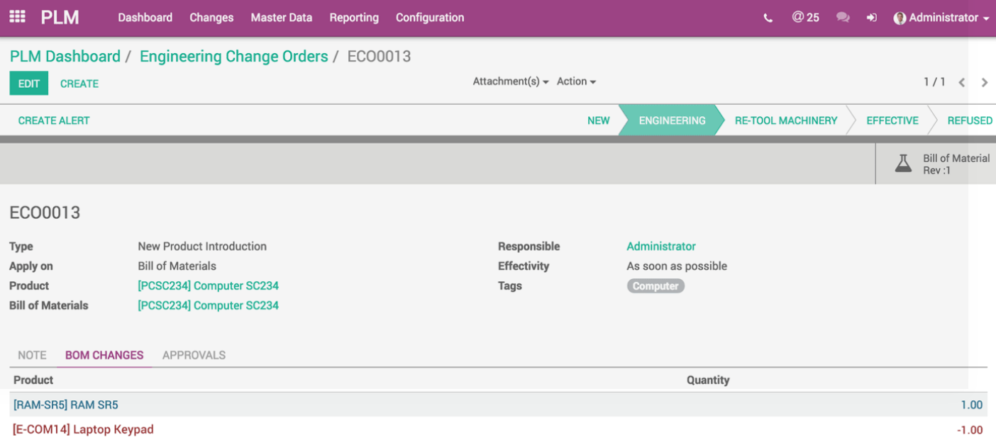
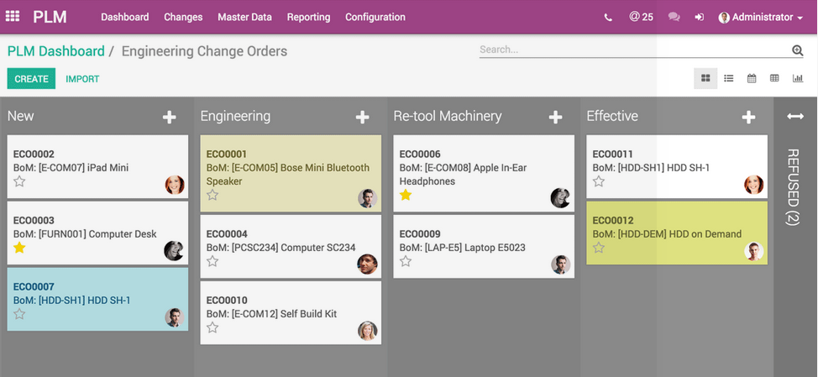
Engineering Change Orders
Managing engineering changes efficiently across multiple departments
Following and approvals are simple
Discussions on documents are centralized and in real time

Slide 10
Material requirements planning (MRP)

Slide 11


MRP
Sales Orders (Sales)
BoM
(Engineering)
MRP
Engine (Planing)
Routings, Manufacturing orders, and Work Orders (Production Operations)
Quality Control Points and Maintenance Management (Production Control)
Purchase Requisition (Material Control)
Purchase Orders (Purchasing)
Receiving, Inventory, Shipping = ”Closed Loop MRP”
Finances and Sales Order Management
Cost Accounting
MRP

Slide 12
Bill of Materials vs. Kit

Slide 13

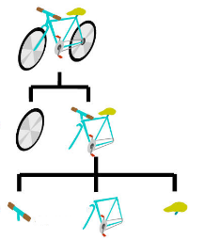
Bill of Materials vs. Kit
1
Materials
Finished Product
Bill of Materials (BoM)
Finished Product
Final output of a manufacturing process
Materials
Required input to manufacturing a product
2
Components
Set
Set of Products as a Kit
Set of components that are described by a bill of materials, but which are delivered separately rather than assembled or mixed.
Components
Brush set

Slide 14
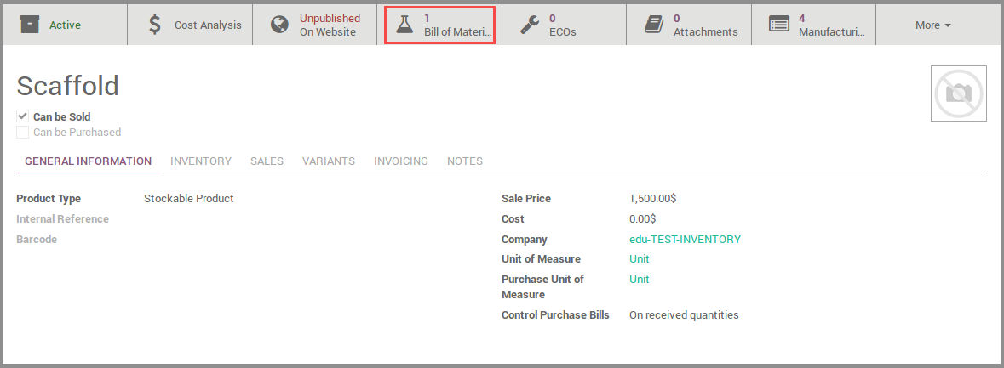
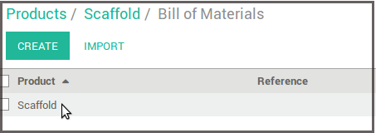
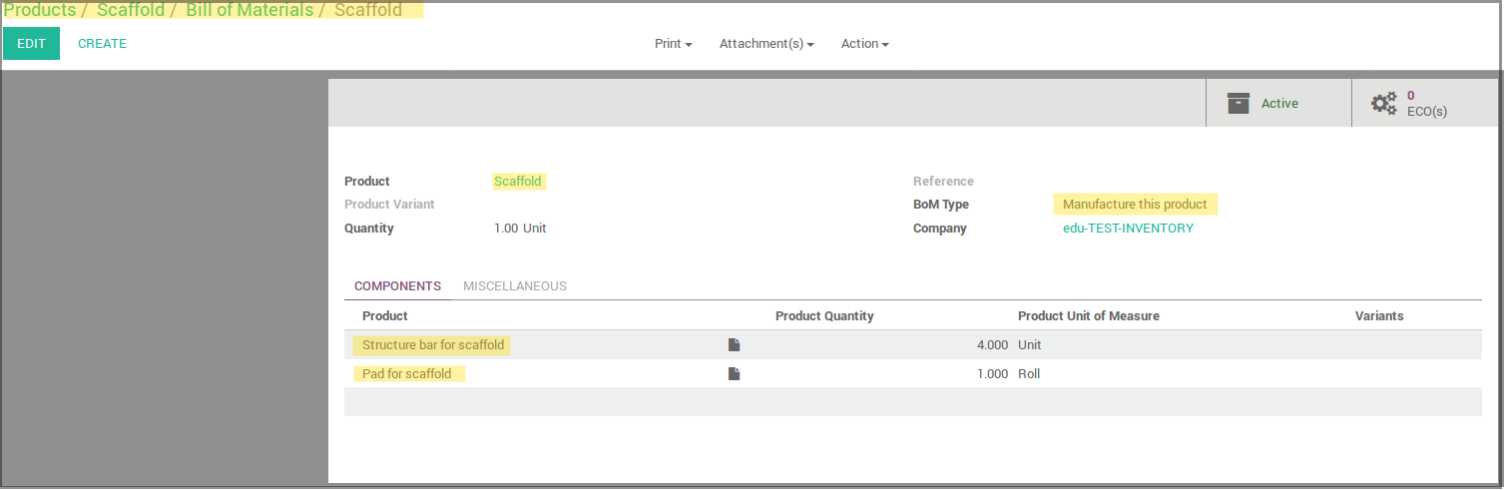
Bill of materials

Slide 15
Concept of Multi-level Bill of Materials
BoM
Product 7
BoM
BoM
Product 5
Product 6
Product 1
Product 2
Product 3
Product 4
The product 5 is the result of a manufacturing process composed of products 1 and 2
The product 6 is the result of a manufacturing process composed of products 3 and 4
The product 7 is the result of a manufacturing process composed of products 5 and 6
  When creating a manufacturing order for Product 6, Odoo will also create automatically a manufacturing order for Product 3 (Phantom BoM)

Slide 16
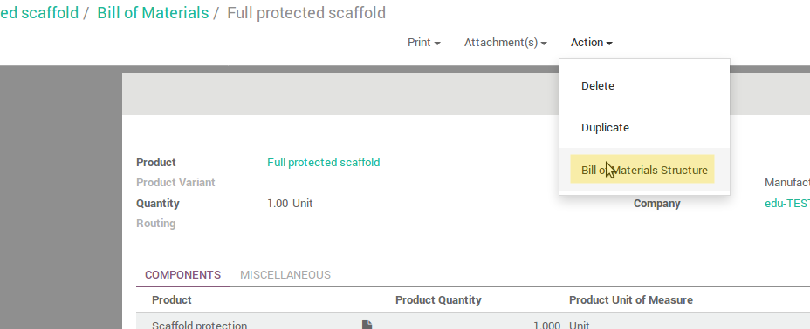
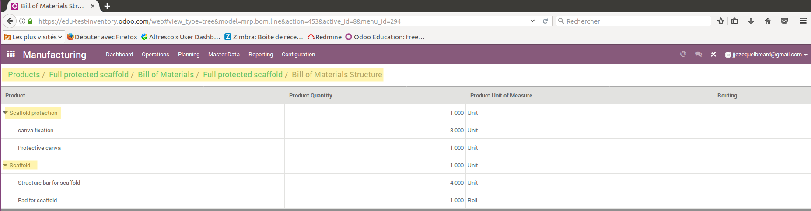
View of BOMs Structure
From the BoM form, you can access the view of the BoM Structure. If the BoM is composed of subassembly products, you will see the detail of these subassemblies.

Slide 17
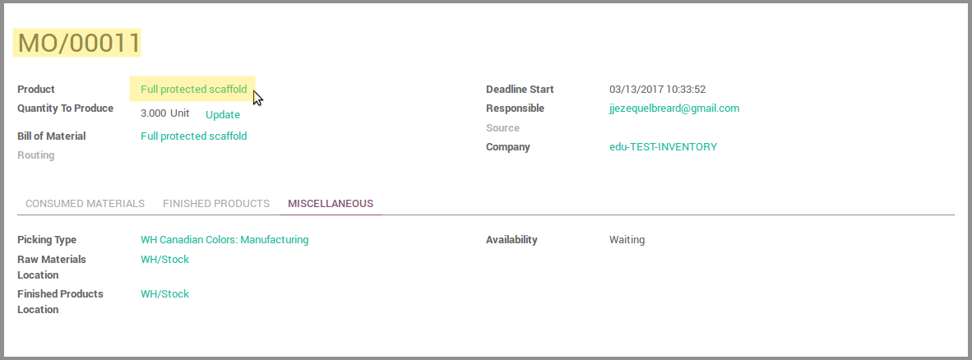
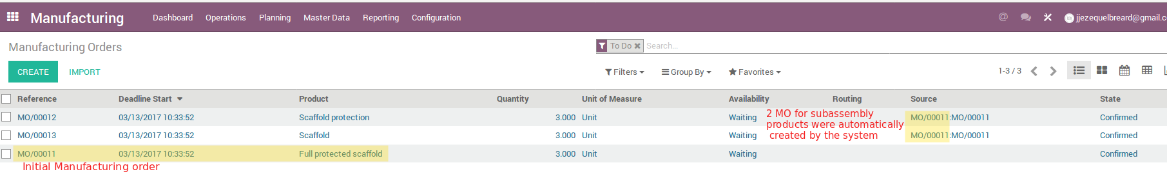
Using Phantom BoM
When a multi-level BoM is recorded, a manufacturing order created for the final product will create automatically manufacturing orders for subassembly products. The Manufacturing Order for the final product is referenced as the source for subassembly MO that was automatically created.

Slide 18
Exercise : Recording Bill of Materials
Canadian Color wants to sell scaffolds. They want to track the production activity in their system.
Also, they want to offer 2 options and an accessory that could be sold as a product or sell with a scaffold. Here are the details of their goals as for these new products :
    Scaffold (stockable product, sold and manufactured)
          Scaffold platform (x2 units) : stockable material, can be purchased. Quantity on hand: 150
          Structure scaffold bar (x8 units) : stockable material, can be purchased. Quantity on hand: 200
        Sale price : 1.500 CAD
    Scaffold protection tarp (stockable product, sold separately or included in the full protected Scaffold, manufactured) :
          Protection tarp (x1 unit) : stockable material that can be purchased. Quantity on hand:100
          Tarp fixations (x8 units) : stockable material that can be purchased. Quantity on hand:200
        Sale price : 500 CAD
    Full protected scaffold (stockable material that is not only sold but also produced) :
          Scaffold (x1 unit)
          Scaffold protection scarp (x1 unit)
        Sales price : 2.500 CAD

Slide 19
Exercise : Recording Bill of Materials
60 min
TO DO :
Search for the product named ‘Scaffolding’ and archive it.
Use the components to create each product and BoMs.
When you have done the Scaffold and the Scaffold protection tarp, process the last product.
Use only Manufacture BoM option.
All products are stockable products.
You will launch a production order if you only have a valid customer order for these products. Use the correct product configuration for this case.
Don’t register Sale orders for now, there is remaining configuration to process before you can check your system is functional.

Slide 20
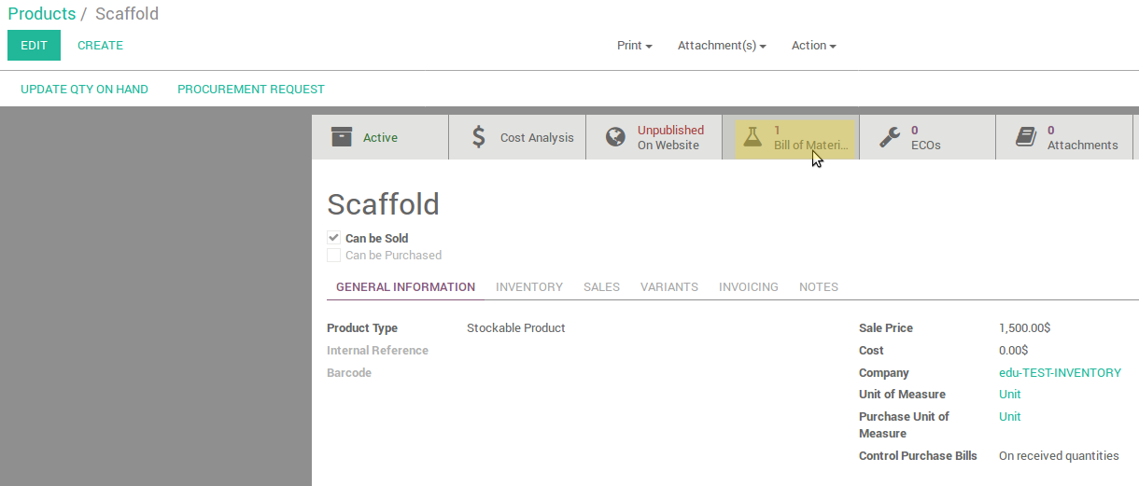
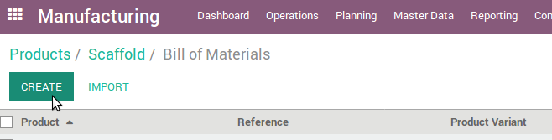
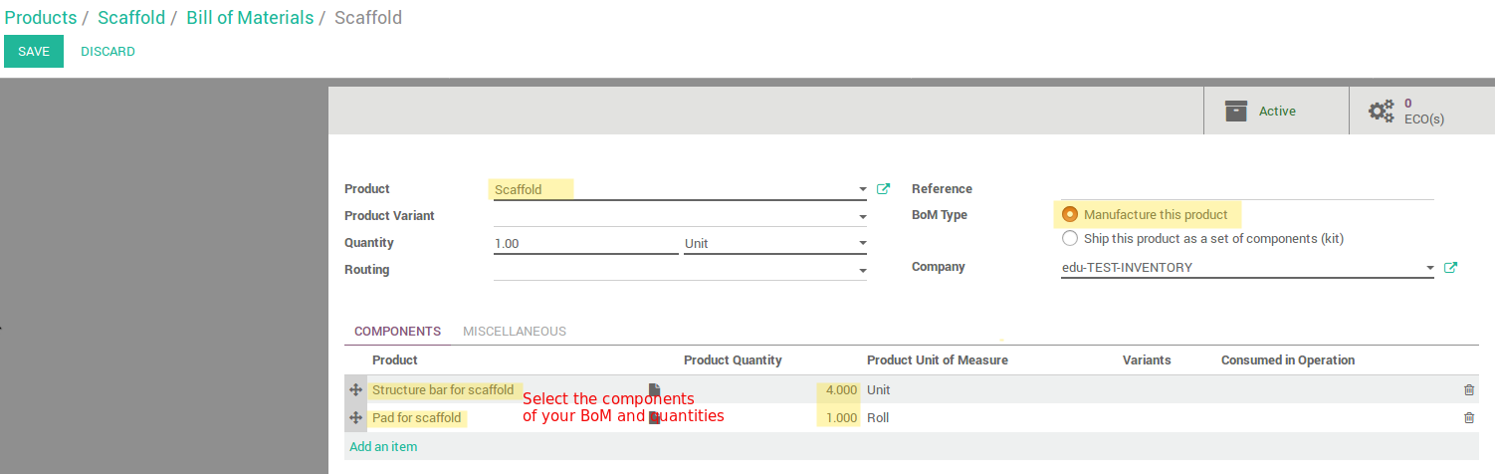
Create a BoM

Slide 21
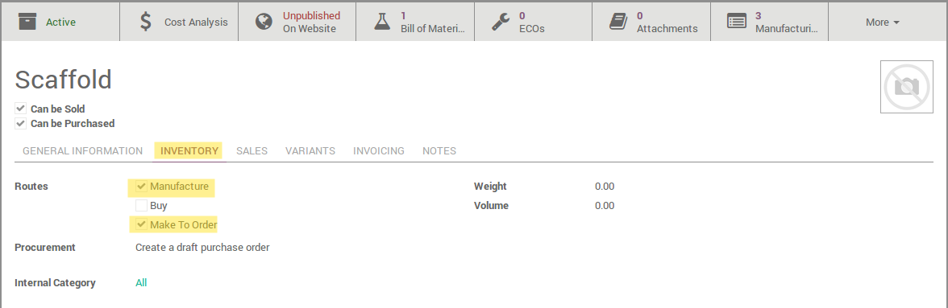
Triggering a manufacturing order
When you select ‘Make to Order’ on the product form for a manufactured product, the confirmation of a sale triggers a manufacturing order automatically.
The manufacturing order will be linked to the sale order.

Slide 22
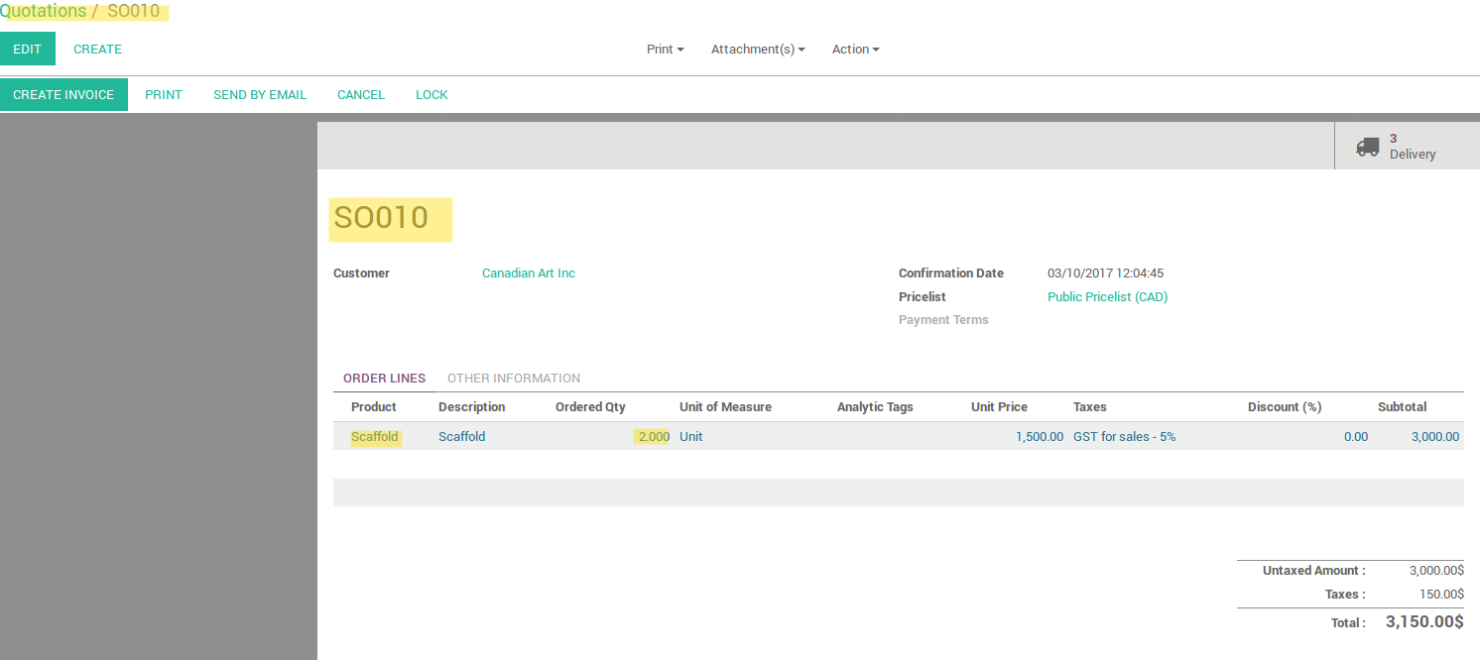
Triggering a manufacturing order
The quotation SO010 has been confirmed and convert into a sale order.

Slide 23
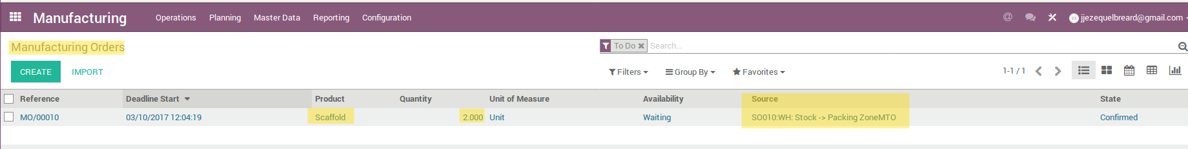
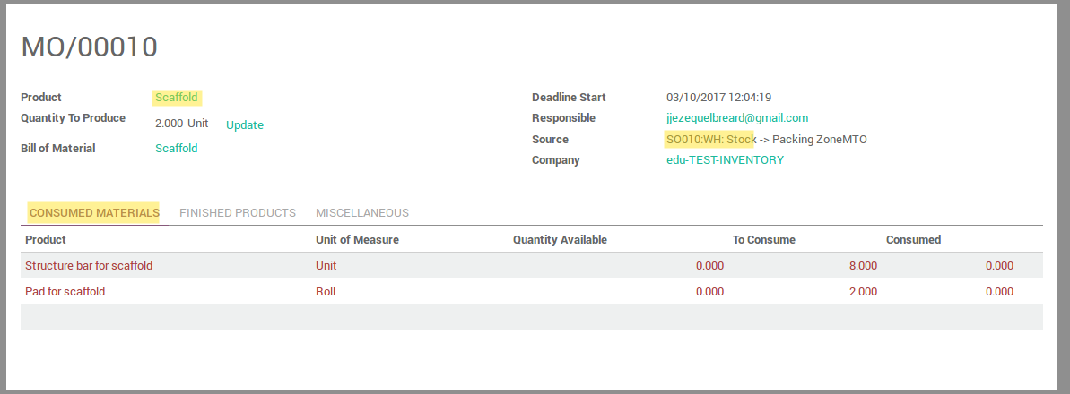
Triggering a manucfacturing order
When a manufacturing order is created in the system, the original sale order (e.g. SO010) is referenced as the document source of this production operation.

Slide 24
Manufacturing Management

Slide 25
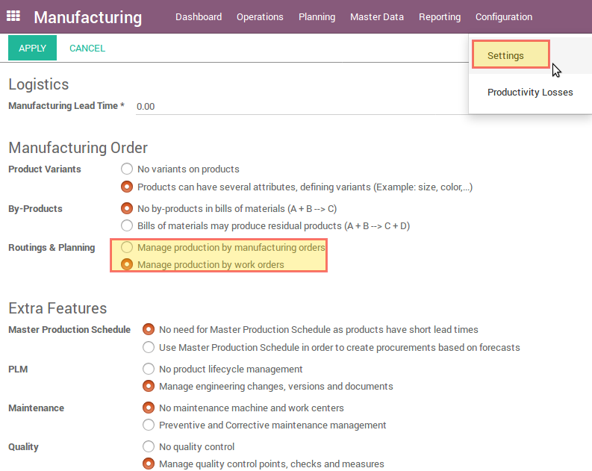
Work order vs. Manufacturing order
The system allows managing only one manufacturing team without tracking the detail of operations or setting work centers as specific production units.
Using the work center module, you can set the plants capacity (defined by resources and their availability)

Slide 26
Production Operations
Work Order (WO)
Routing Operations
Routing codes by item
Tasks / Operations
W/C – Task Relationships
Work Centers
Production Units / Ressources

Slide 27
Manufacturing Order Process
Choose BoM
Create a MO
Isssue
MO
Start
WO
Pick
WO
Finish
WO
Choose a
routing

Slide 28
Exercise : Configure your work centers
60 min
Canadian Color wants to track its production activities for all Scaffold type products. Production is made through 2 work centers :
    Collecting components (code CO-01)
    Assembling components (code AS-01)
Create the 2 work centers to track these activities and fill out all necessary information
Here is the routing to create to fit with the 2 operation types :
    Components are gathered (work center CO-01) : No material is consumed at this operation
    Components are visually double-checked (work center CO-01) : No material is consumed at this operation
    Products are assembled (work center AS-01) : Components are consumed at this stage.
Create the routing with the two operations. Name the routing as to identify it easily (example : default production route)
Go back on the products you just created, and in the BoM, set the production routing and indicate that the material is consumed in the Assembly operation
Create a sale order for one of your client for the product ‘Full protected scaffold’ (15 units). Confirm the sale.
You should be able to find 3 manufacturing orders : one for Scaffold, one for Scaffold protection tarp and one for full protected scaffold.
Process the manufacturing orders. Begin with the ones available.

Slide 29
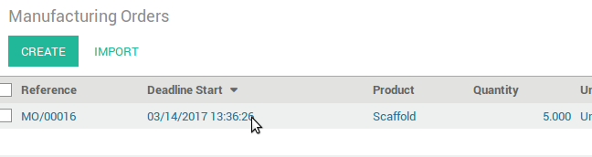
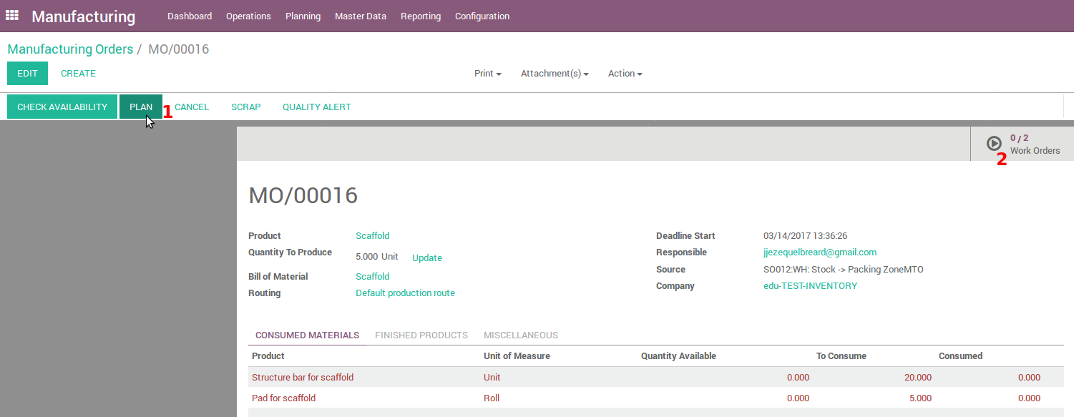
Process manufacturing orders
Click on the MO in the list view
Click on [Plan] and then click on [Work orders] to edit them

Slide 30
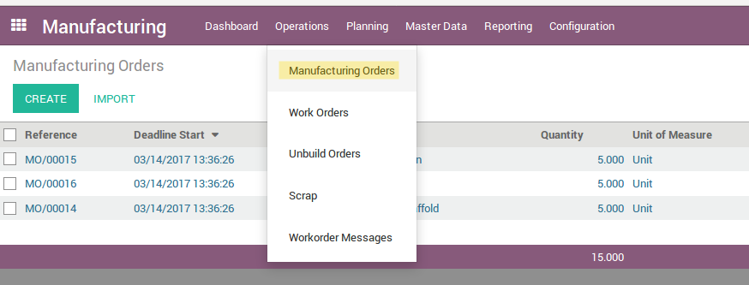
Find manufacturing orders
View of manufacturing orders:

Slide 31
Process manufacturing orders
Click on the MO in the list view
Click on [Plan] and then click on [Work orders] to edit them

Slide 32
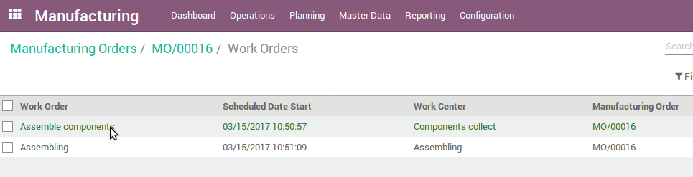
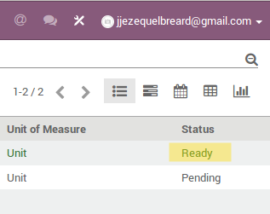
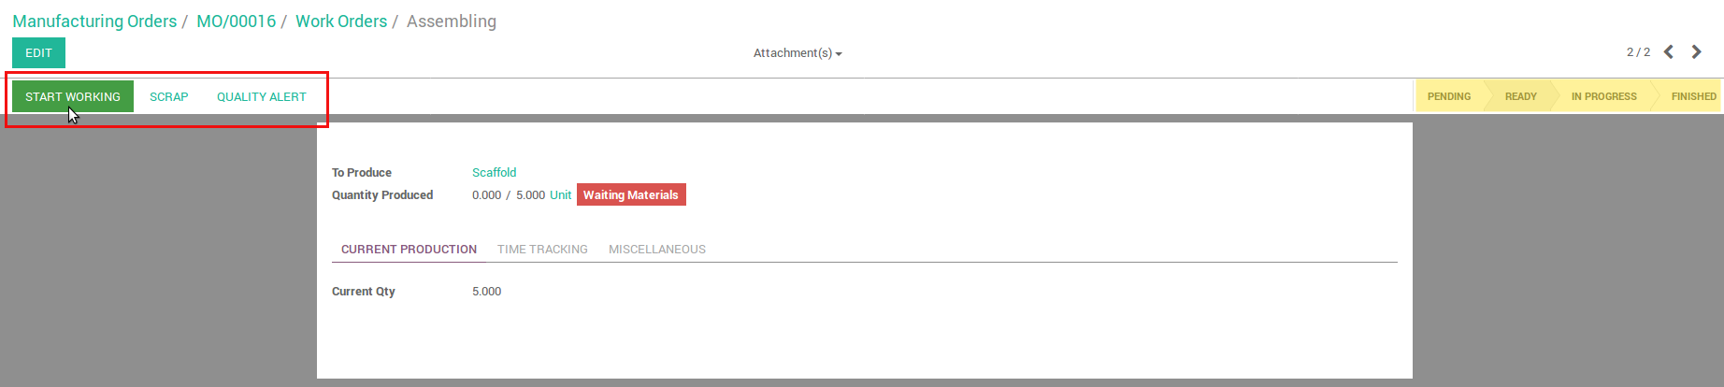
Process manufacturing orders (1)
Click on the WO in the list view.You can only begin with the first operation of your routing. The WO is ready to start the process and pending for the next operation of the routing.
In the Work Order form, you can see the status on the top right corner, and register actions on it. Click [Start working] to process the WO.

Slide 33
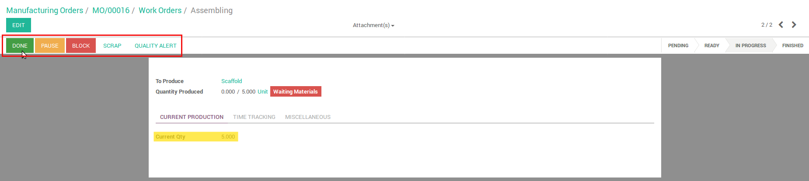
Process manufacturing orders (2)
Once you have started the WO, click [Done] to record the end of production for this WO. Click [Pause] to suspend tracking production time.
The field ‘Current Qty’ is set with the quantity to produce when opening the WO. When you click [Done], the quantity in ‘Current Qty’ is set to 0.00 and the field ‘Quantity produced’ is updated with the quantity initially required for the WO.

Slide 34
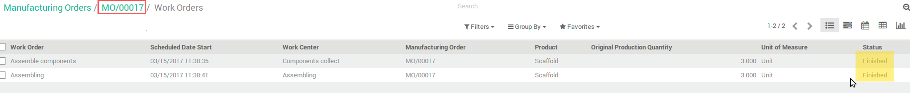
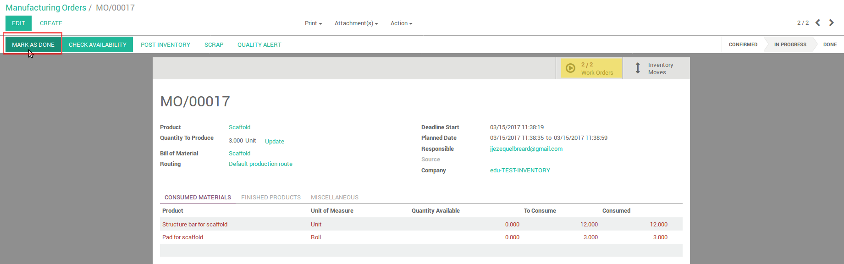
Run your manufacturing order
Go back to your WO list linked to your MO, clicking on ‘Work Orders’ in the path link. Edit the second WO and process it.
When you are done with the second WO, go back to the WO list view, and see that all WO status are “finished”.
When you are done with the second WO, go back to the MO form. See that the smart button [Work orders] is updated. You can click [Mark as done] to end your MO.
Repeat this for the second remaining Manufacturing orders from your MO list view.

Slide 35
Quality control

Slide 36
Quality Assurance
In process quality checking in manufacturing
Validation of facilities, equipment, process, products and cleaning
Storage of quality records and control samples (sampling)
Tools & Techniques
Statistical Analysis
Testing
Verifying
Validation Procedures to ensure that work is done right the first time

Slide 37
Quality Assurance
Product
Operation
Reception Orders
Manufacturing
Delivery Orders
Responsible manager
Control Type
All operations
Randomly
Periodically
Quality Control Points
Product
Lot
Control Point
Take actions (Pass/Fail)
Quality Checks

Slide 38
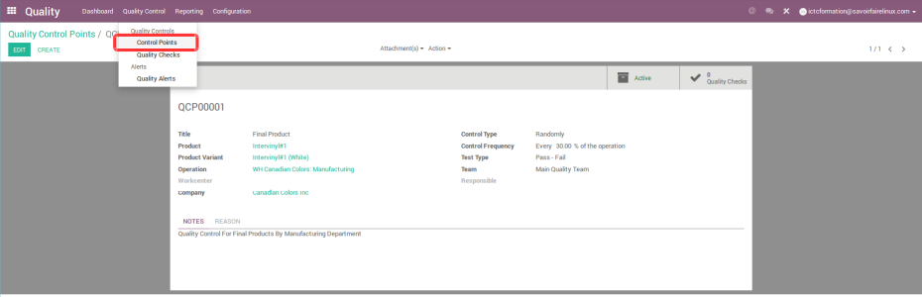
Quality Control Points

Slide 39
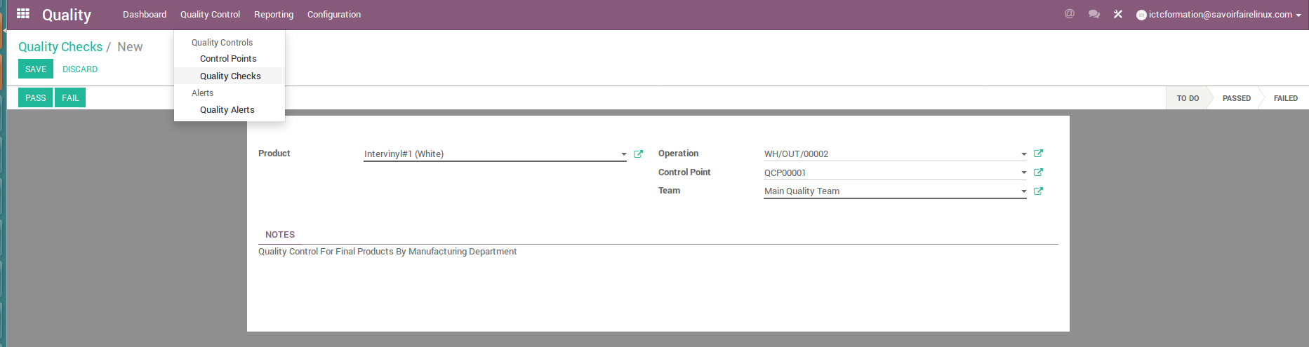
Quality Checks

Slide 40
Exercise : Configure your quality control
60 min
Canadian Color wants to control the reliability of its scaffold for each manufactured product.
TO DO :
Create a quality check on the Scaffold product according to the following information :
      Each manufactured product must be controled
      The test should occur at the end of the manufacturing process
      The result of the test is Passed or Failed
      The test is the following : to put 300 Lbs on the Scaffold platform in order to confirm that the product is solid, give detail through the text zone ‘Notes’
Create a manufacturing order (via a Sale order) to process the manufacturing and verify the test is effective
Process the work orders through the Manufacturing order, and verify that in the last operation (Assembling), you have to register the Quality test.
Hit ‘Pass’ and finish the Work order and Manufacturing order
Extra exercice : launch and manage a new manufacturing order for this product, and clic ‘Failed’ during the test. Then search in your Quality module how to manage this and get the test OK. You can configure your pipeline and create actions to make on the Quality check.

Slide 41
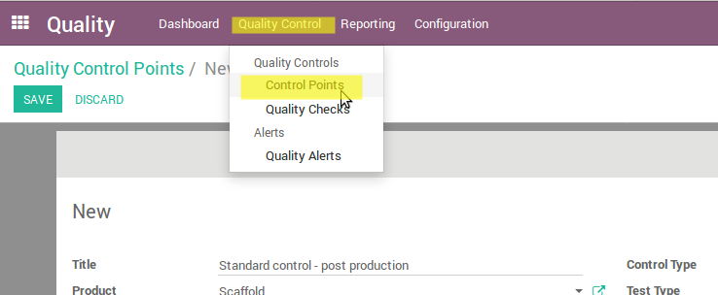
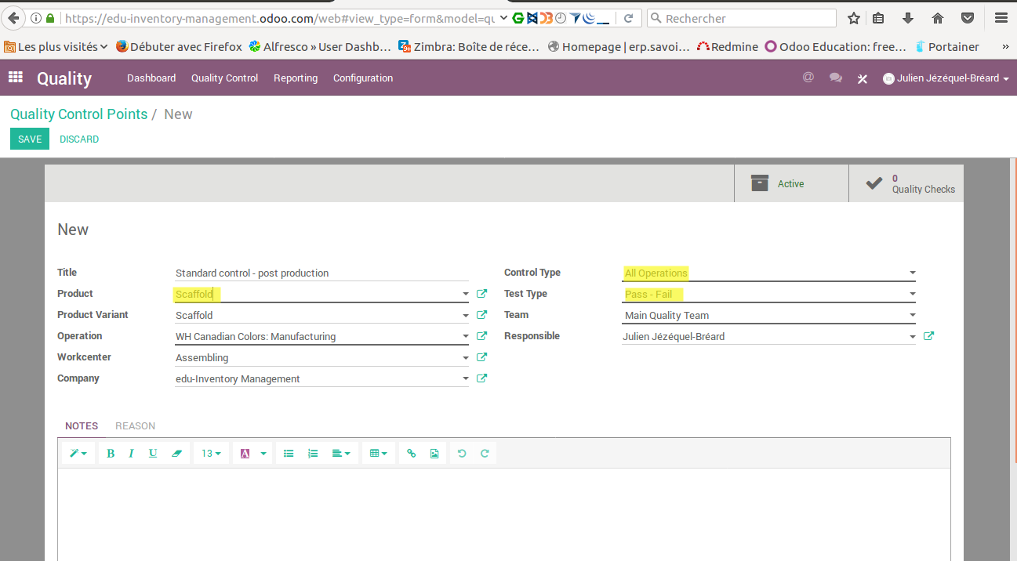
Quality Check creation

Slide 42
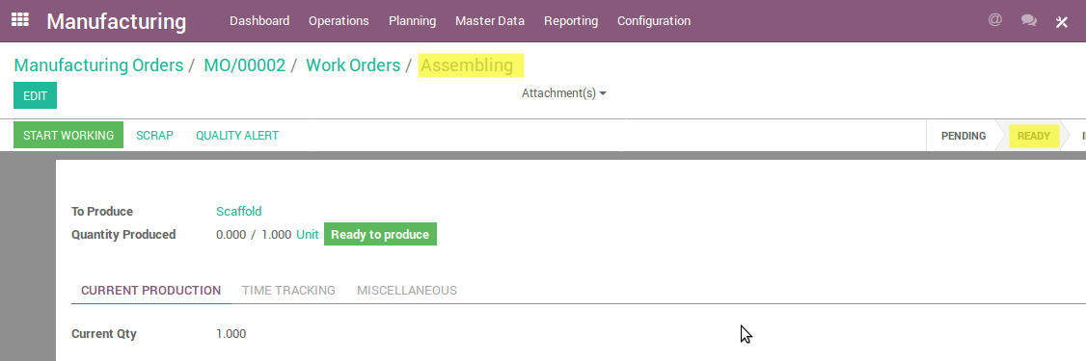
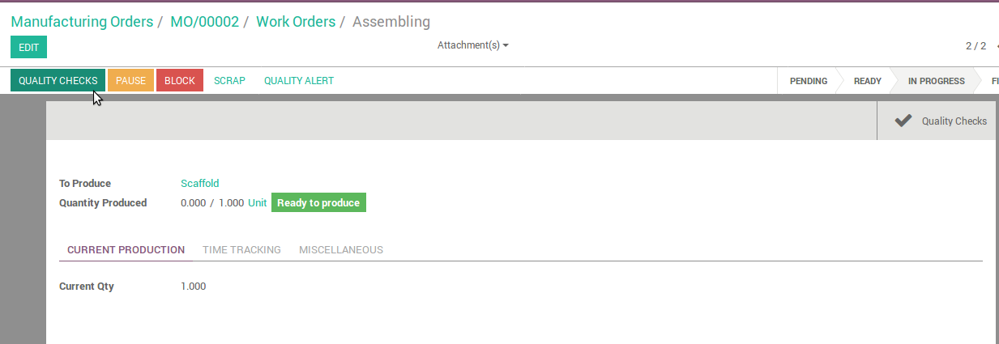
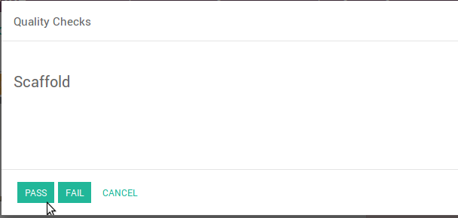
Quality Check process

Slide 43
Maintenance

Slide 44
Manage Maintenance process
Asset Maintenance, Repair and Operation
Preventive and Corrective Maintenance Management
Request Service/Maintenance Management
Maintenance Work Orders Management
Parts Management
Tasks Management

Slide 45
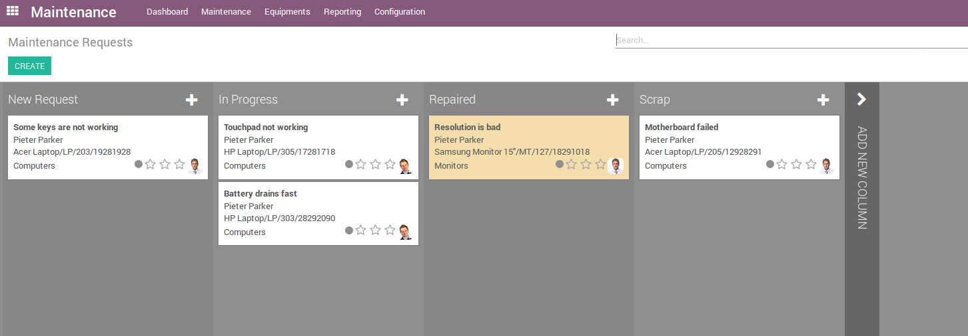
Maintenance Requests
Pipeline to manage maintenance requests:

Slide 46
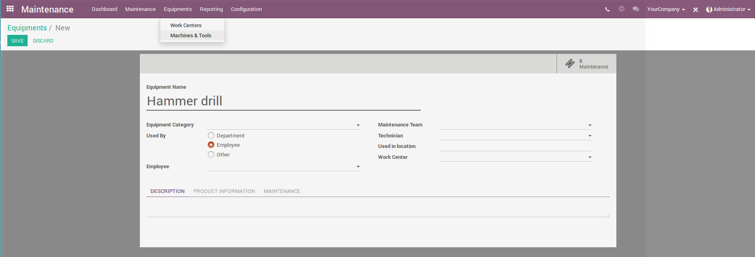
Registration of equipment and tools
This module allows recording not only equipment, machines, and tools, but also work centers which will be object to the repair.

Slide 47
Contributions
This document has been authored and distributed by the functional team of Odoo, Savoir-faire Linux :
Carolandrea Guerrero
Mickaël Brard
Marc Lijour
Julien Jézéquel-Bréard
Bruno Joliveau
Quentin Lavallée
Adriana Ierfino
Guillaume Lot
You can download this training document, use and modify it (within diposals and limits of the applicable licence CC-BY-NC-SA), at the following url : https://github.com/savoirfairelinux/training-odoo

Slide 48

Solutions de gestion informatique

